Slide 1
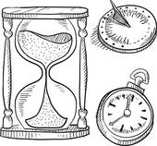
Eternal Issues
eternalissues@cox.net

Slide 2
Ekklesia (ek-klay-see'-ah);
from a compound of NT:1537 and a derivative of NT:2564;
a calling out
“called out ones”
(Biblesoft's New Exhaustive Strong's Numbers and Concordance with Expanded Greek-Hebrew Dictionary. Copyright © 1994, 2003, 2006 Biblesoft, Inc. and International Bible Translators, Inc.)

Slide 3
Matt 22:14 NASU
"For many are called, but few are chosen."

Slide 4
chirche and cirice meaning “circle”
Greek phrase kuriake oikia, meaning “lord’s house”

Slide 5
“’We have no temples or altars.’ This statement, referring to Christians, comes from the pen of the apologist Minicus Felix, c200, and all evidence supports its accuracy. Throughout at least the first two centuries there were no church buildings as such.”
-- The Early Christian Church,
J.G. Davies

Slide 6
“When the church was very young, it had no buildings. Let us begin with that striking fact. That the church had no buildings is the most noticeable of the points of difference between the church of the early days and the church of today. In the minds of most people today, “church” means first a building, probably something else second; but seldom does “the church” stand for anything other than a building. Yet here is the fact that which we start: the early church possessed no buildings and carried on its work for a great many years without erecting any.”
-- When the Church was Very Young,
Ernest Loosley

Slide 7
“Constantine (280-337), the Roman Emperor and his mother, Empress Helena, built many pagan temples. After his conversion in 313, he continued his custom of building, but this time it was “Christian” temples. They simply went from worshiping the pagan gods to the memorializing the dead saints. Many pagan buildings were later converted to churches. This was really the official beginning of recognizing buildings as churches.”
-- The Origin of the Word “church”,
Andy Zoppelt

Slide 8
“…the use of the word “church instead of ‘assembly’ or ‘congregation’ came from those who had a bias towards a hierarchical and unscriptural form of church government.”
“…there is no biblical basis for a church hierarchy outside the local church or local assembly of believers. The only “ekklesia” the New Testament knows is a local assembly of believers.”
--The Translation of the Greek Word “Ekklesia” as “church” in the English Bible and its Ramifications, Cooper P. Abrams, III

Slide 9
Rev 1:11 KJV
Saying, I am Alpha and Omega, the first and the last: and, What you see, write in a book, and send it to the seven churches [ekklesia] which are in Asia; unto Ephesus, and unto Smyrna, and unto Pergamos, and unto Thyatira, and unto Sardis, and unto Philadelphia, and unto Laodicea.
Rev 2:1 KJV
Unto the angel of the church [called out ones] of Ephesus write;

Slide 12
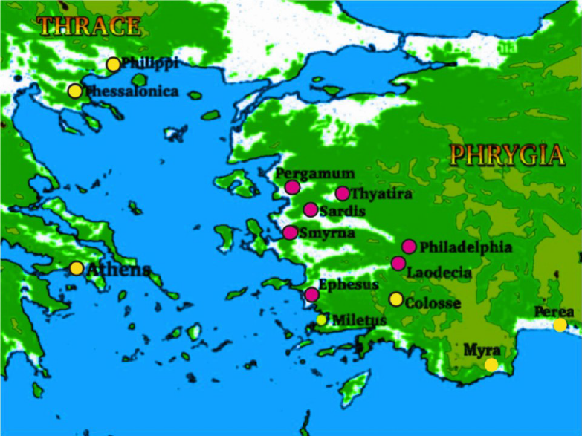

Slide 14
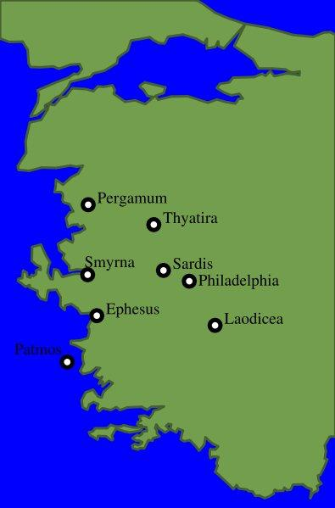

Slide 15
Name
Description/character
Commendation
Reproof
Counsel
Promise

Slide 16
Each church existed in the time of John’s writing, and ALSO represents a future church application.

Slide 17
Located in most important area of Roman Empire 1-3 centuries
Geography point of east/west meeting point
Extremely rich land, beautiful scenery
Made great during the time of Alexander the Great
Source: J. Vernon McGee http://ldolphin.org/cleanpages/rev02.html

Slide 18
Unto the angel of the church of Ephesus write; These things saith he that holds the seven stars in his right hand, who walks in the midst of the seven golden candlesticks;
2 I know your works, and your labour, and your patience, and how you cannot bear them which are evil: and you have tried them which say they are apostles, and are not, and have found them liars:
3 And have borne, and have patience, and for my name's sake have laboured, and have not fainted.
4 Nevertheless I have somewhat against you, because you have left you first love.
5 Remember therefore from whence you art fallen, and repent, and do the first works; or else I will come unto you quickly, and will remove you candlestick out of his place, except you repent.
6 But this you have, that you hate the deeds of the Nicolaitans, which I also hate.
7 He that has an ear, let him hear what the Spirit saith unto the churches; To him that overcomes will I give to eat of the tree of life, which is in the midst of the paradise of God.

Slide 19
EPHESUS “desirable”
Represents the “apostolic church”
Time period: first century A.D.
Chief city of the province of Asia
Population about 200,000
Beautiful city, called “Vanity Fair of Asia” and the “Light of Asia”
Religious and commercial center of entire area, influenced both East and West Europe and Asia
Harbor Boulevard, all white marble
20,000 seat theater
100,000 seat amphitheater
Up to two million gathered in Ephesus at given times
Paul’s ministered here, considered the place of his greatest ministry by some
John pastored here

Slide 20
City formed around temple of Diana
Seat of Diana was in this city, (considered the “mother of gods”, goddess of fertility)
Temple of Diana later known as one of the wonders of the ancient world
Largest Greek temple ever constructed
100+ columns 56-feet high, 36 were hand-carved
Doors: cypress wood, columns & walls: Parian marble, staircase: carved from one vine from Cyprus
Wealthy, prosperous city
Temple served as the bank of Asia, depository of vast sums of money
Art gallery displayed masterpieces
Diana’s temple was FOUR TIMES larger than the Parthenon at Athens
Temple destroyed by Goths in A.D. 256

Slide 21
EPHESUS: “First” or “Desirable”
Character/Commendation: labour, patience, intolerance of evil, tested and tried false apostles, calling them liars, labored with patience and endurance for Christ, did not faint or give up; hate the deeds of the Nicolaitans
Reproof: Left your first love
Counsel: REPENT, do again your first works
Warning: will remove your candlestick! [church]
Reward for overcomers: eat of the tree of Life
Time period represented: first century A.D. [32 A.D.-100 A.D.]

Slide 22
8 And unto the angel of the church in Smyrna write; These things saith the first and the last, which was dead, and is alive;
9 I know you works, and tribulation, and poverty, (but you are rich) and I know the blasphemy of them which say they are Jews, and are not, but are the synagogue of Satan.
10 Fear none of those things which you shall suffer: behold, the devil shall cast some of you into prison, that you may be tried; and you shall have tribulation ten days: be faithful unto death, and I will give you a crown of life.
11 He that has an ear, let him hear what the Spirit saith unto the churches; He that overcomes shall not be hurt of the second death.

Slide 23
SMYRNA “myrrh”
Represents the martyred church
Modern day city: Izmir, Turkey
Continuously inhabited since its founding
Commercial center, large population
Beautiful harbor, lovely city, called a “flower, an ornament, the crown of Asia”
Acropolis located on Mount Pagos
Acropolis encircled with flowers, hedge, and myrtle trees
Temples to: Zeus, Cybele (Diana), Aprhodite, Apollo, Aesculapius
Shrine to goddess Nemesis
Theater, Odeum (music center), considered home of music, Stadium where Polycarp was martyred

Slide 24
Nero: 64-68 (Paul was beheaded under his reign)
Domitian: 95-96 (John was exiled during that period)
Trajan: 104-117 (Ignatius was burned at the stake)
Marcus Aurelius: 161-180 (Polycarp was martyred)
Severus: 200-211
Maximinius: 235-237
Decius: 250-253
Valerian: 257 -260
Aurelian: 270-275
Diocletian: 303-313 (the worst emperor of all).

Slide 25
SMYRNA: Myrrh, “sweet-smelling” <an aroma of sacrifice>
Character/Commendation: works, tribulation, and poverty, (but you are rich) and I know the blasphemy of them which say they are Jews, and are not, but are the synagogue of Satan.
Reproof: NONE
Counsel: Be faithful unto death
Warning: will have tribulation ten days (years)
Reward for overcomers: crown of life
Time period represented: 100 A.D.-313 A.D.

Slide 26
12 And to the angel of the church in Pergamos write; These things saith he which has the sharp sword with two edges;
13 I know your works, and where you dwell, even where Satan's seat is: and you hold fast my name, and have not denied my faith, even in those days wherein Antipas was my faithful martyr, who was slain among you, where Satan dwells.
14 But I have a few things against you, because you have there them that hold the doctrine of Balaam, who taught Balac to cast a stumbling block before the children of Israel, to eat things sacrificed unto idols, and to commit fornication.
15 So you also have them that hold the doctrine of the Nicolaitans, which thing I hate.
16 Repent; or else I will come unto you quickly, and will fight against them with the sword of my mouth.
17 He that has an ear, let him hear what the Spirit saith unto the churches; To him that overcomes will I give to eat of the hidden manna, and will give him a white stone, and in the stone a new name written, which no man knows saving he that receives it.

Slide 27
PERGAMOS “elevation”
Turkey spells it “Pergamum”
Great religious center (of paganism)
Capital of the kingdom of Pergamum, Capital of the Roman province of Asia
Built on a mountain
Beautiful spot of Asia Minor, illustrious city
Temple of Zeus and Ascelepius [serpent god], temple of Dionysius/Bacchus (goat god, god of wine)
Acropolis
Held the greatest library of the pagan world, later carted off to Alexandria by Cleopatra
Great “healing center” of its day…

Slide 28
Proconsul of Pergamos held a double-edged sword
[proconsul is the appointed governor of a province appointed by the Roman Senate for year terms]
Babylonian priesthood took the Dagon [fish god] Palladium Stone, vestments, title (pontifex maximus= bridge between heaven and earth), keys and mitre with them to Pergamum. This title is represented with the initials PM. You’ll find them behind Roman emperors names and Pope names.
Antipas means “anti-pontiff”
The last pontiff king of Pergamum was Attalus III. He bequeathed his title to Rome in 133 B.C.
Christian emperor Gratian refused the title and robes of Pontifex Maximus, and it then went to the bishop of Rome in Damascus. [he was the first emperor to do this]

Slide 29
PERGAMOS: “elevation, power, elevation by marriage”
Character/Commendation: Dwell where satan’s seat is, hold fast to Christ’s name, and have not denied faith, … Antipas faithful martyr
Reproof: tolerance for doctrine of Balaam, idolatry, fornication, doctrine of the Nicolaitans. Compromise.
Counsel: Repent; or else I will come unto you quickly, and will fight against them with the sword of my mouth.
Warning: none
Reward for overcomers: hidden manna, white stone, new name
Time period represented: 313 A.D.- 500ish A.D.

Slide 30
Negatives of Pergamos period of the Church:
Compromise
Religion
Positives of Pergamos period of Church:
Faith

Slide 31
18 And to the angel of the church in Thyatira write; These things saith the Son of God, who has his eyes like a flame of fire, and his feet are like fine brass;
19 I know your works, and charity, and service, and faith, and your patience, and your works; and the last to be more than the first.
20 Notwithstanding I have a few things against you, because you suffer that woman Jezebel, which calls herself a prophetess, to teach and to seduce my servants to commit fornication, and to eat things sacrificed to idols.
21 And I gave her space to repent of her fornication; and she repented not.
22 Behold, I will cast her into a bed, and they that commit adultery with her into great tribulation, except they repent of their deeds.
23 And I will kill her children with death; and all the churches shall know that I am he which searches the reins and hearts: and I will give to every one of you according to your works.
24 But to you I say, and to the rest in Thyatira, as many as have not this doctrine, and which have not known the depths of Satan, as they speak; I will put upon you none other burden.
25 But that which you have already hold fast till I come.
26 And he that overcomes, and keeps my works unto the end, to him will I give power over the nations:
27 And he shall rule them with a rod of iron; as the vessels of a potter shall they be broken to shivers: even as I received of my Father.
28 And I will give him the morning star.
29 He that has an ear, let him hear what the Spirit saith to the churches.

Slide 32
Thyatira “sweet savor of labor; sacrifice or contrition; satan’s teaching”
Inland city built by Lysimachus and again by Seleucus I
Chief route of Asia Minor travel and communication
City of defense with an elite Roman guard
Known city of textile industries
Famous for its dyes, especially its purple and crimson dyes made from madder roots
Lydia, Paul’s first European convert from Thyatira
Temple of Apollo [sun-god] (aka: Tyrimnos) and another altar to a female goddess

Slide 33
THYATIRA: “sweet savor of labor, sacrifice of contrition, satan’s teaching”
Character/Commendation: charity, and service, faith, patience, and your works; and the latest deeds more than the first
Reproof: tolerates Jezebel, idolatry, immorality.
Counsel: Hold fast what you already have
Warning: those caught up in Jezebel doctrine will face great tribulation and children (offspring of those in this system) will be killed
Reward for overcomers: authority/power over the nations, morning star
Time period represented: 500ish A.D.-1000s (possibly 1500s)

Slide 34
3 And unto the angel of the church in Sardis write; These things saith he that has the seven Spirits of God, and the seven stars; I know your works, that you have a name that you live, and are dead.
2 Be watchful, and strengthen the things which remain, that are ready to die: for I have not found your works perfect before God.
3 Remember therefore how you have received and heard, and hold fast, and repent. If therefore you shall not watch, I will come on you as a thief, and you shall not know what hour I will come upon you.
4 You have a few names even in Sardis which have not defiled their garments; and they shall walk with me in white: for they are worthy.
5 He that overcomes, the same shall be clothed in white raiment; and I will not blot out his name out of the book of life, but I will confess his name before my Father, and before his angels.
6 He that has an ear, let him hear what the Spirit saith to the churches.

Slide 35
SARDIS “renewal”… “that which remains” …. “reformation”
Capital of Lydia, very wealthy city
Old part of the city was on a plateau, new city below it, making almost a double city
Old part used as acropolis
Center of the carpet industry
Coins first minted here
Temple of Diana/Cybele (moon goddess) and Apollo (sun god)
Some say like the modern city of Prague
City was impregnable but was taken twice without resistance by Cyrus and Antiochus

Slide 36
SARDIS: “renewal…that which remains…reformation”
Character/Commendation: a few names with undefiled garments, reputation of being alive
Reproof: you are dead, incomplete works
Counsel: be watchful, strengthen that which remains and is about to die, hold fast and remember that which heard and received, repent
Warning: if will not watch, will come as a thief
Reward for overcomers: white garments for dress, name kept in Book of Life
Time period represented: 1000/1500s-1800

Slide 37
7 And to the angel of the church in Philadelphia write; These things saith he that is holy, he that is true, he that has the key of David, he that opens, and no man shuts; and shuts, and no man opens;
8 I know your works: behold, I have set before you an open door, and no man can shut it: for you have a little strength, and have kept my word, and have not denied my name.
9 Behold, I will make them of the synagogue of Satan, which say they are Jews, and are not, but do lie; behold, I will make them to come and worship before your feet, and to know that I have loved you.
10 Because you have kept the word of my patience, I also will keep you from the hour of temptation, which shall come upon all the world, to try them that dwell upon the earth.
11 Behold, I come quickly: hold that fast which you have, that no man take your crown.
12 Him that overcomes will I make a pillar in the temple of my God, and he shall go no more out: and I will write upon him the name of my God, and the name of the city of my God, which is new Jerusalem, which comes down out of heaven from my God: and I will write upon him my new name.
13 He that has an ear, let him hear what the Spirit saith to the churches.

Slide 38
PHILADELPHIA “brotherly love”
City was named for Attalus II’ s love for his brother Eumenes
City formed a gateway through the mountains (an open door)
Culture was Greek
Fortress to impede attacks on the 3 great cities of Ephesus, Smyrna and Pergamum
Fertile land, wine country
Bacchus (wine god) on coins
Destroyed by an earthquake A.D. 17 and rebuilt
Byzantine church there
Christian church in Philadelphia through 13th century

Slide 39
PHILADELPHIA: “brotherly love”
Character/Commendation: works, have a little strength, kept my word, not denied my name, kept the word of my patience
Reproof: NONE
Counsel: hold fast to what you have
Warning: will make false believers (liars) know God has loved them/true believers
Reward for overcomers: keep you from the hour of temptation that will try those on earth, pillar in God’s temple, God’s new name written on
Time period represented: 1790s-1948 [some say 1840s/1900ish]

Slide 40
World Missions
Cary: India 1793
Morrison: China 1807
Moffet: Africa 1817
British Bible Society 1804
American Bible Society 1816

Slide 41
14 And unto the angel of the church of the Laodiceans write; These things saith the Amen, the faithful and true witness, the beginning of the creation of God;
15 I know your works, that you are neither cold nor hot: I would you were cold or hot.
16 So then because you are lukewarm, and neither cold nor hot, I will spew you out of my mouth.
17 Because you say, I am rich, and increased with goods, and have need of nothing; and know not that you are wretched, and miserable, and poor, and blind, and naked:
18 I counsel you to buy of me gold tried in the fire, that you may be rich; and white raiment, that you may be clothed, and that the shame of your nakedness does not appear; and anoint your eyes with eyesalve, that you may see.
19 As many as I love, I rebuke and chasten: be zealous therefore, and repent.
20 Behold, I stand at the door, and knock: if any man hear my voice, and open the door, I will come in to him, and will sup with him, and he with me.
21 To him that overcomes will I grant to sit with me in my throne, even as I also overcame, and am set down with my Father in his throne.
22 He that has an ear, let him hear what the Spirit saith to the churches.

Slide 42
LAODICEA “nation of judgment” … “judging the people” … “justice of the people”
Called the “city of compromise” by Sir William Ramsey
Founded by Anitochus II [261-246 B.C.], named after his wife
Destroyed in 60 A.D. by earthquake but rebuilt with its own funds
Gate city in a great valley
City of great wealth and commerce, Greek culture
Place of science and literature, medical school
Renown for its eye and ear salve, Phrygian
Center of industry and banking operations
Place of great clothing commerce
Cicero held court here
had a health resort, sold “collyrium”, an eye salve
city supported a health industry

Slide 43
LAODICEA: ““nation of judgment” … “judging the people” … “justice of the people”
Character/Commendation: NONE
Reproof: lukewarm, spiritually: wretched, miserable, poor, blind, and naked
but physically: rich, and increased with goods, and have need of nothing
Counsel: BUY OF ME (CHRIST): gold tried in the fire, that you may be rich; and white raiment, that you may be clothed, and that the shame of your nakedness does not appear; and anoint your eyes with eyesalve, that you may see. Be zealous and REPENT.
Warning: God will spew out of His mouth
Reward for overcomers: sit with Christ in His Throne
Time period represented: [1840/1900ish] 1948-Christ’s return

